Slide 1

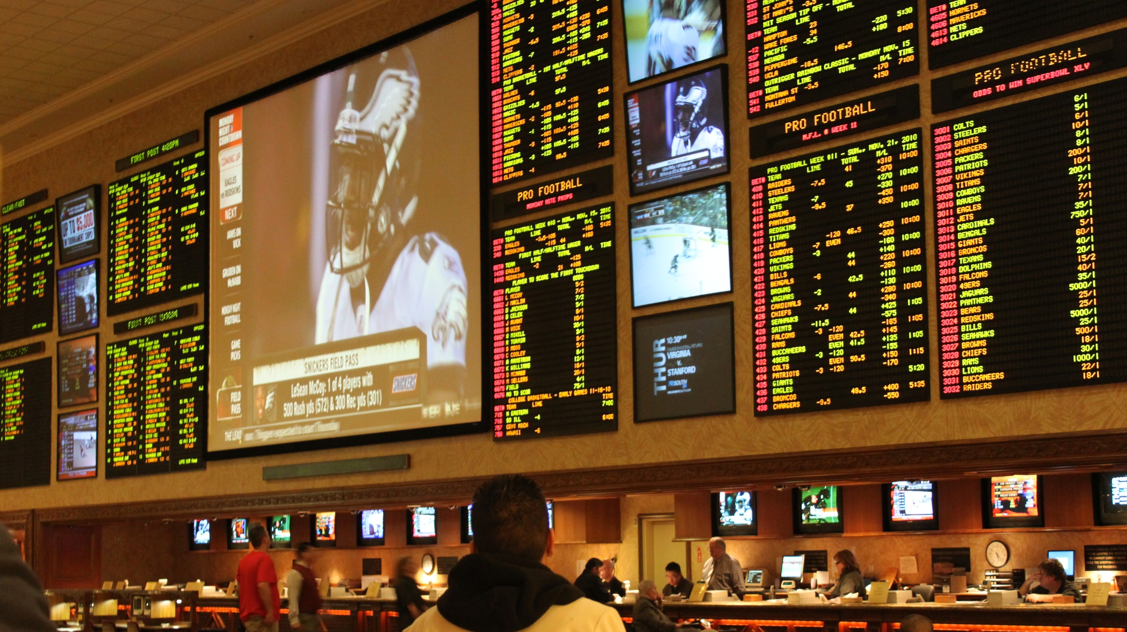


CHANCER: A MOBILE APP SOLUTION TO PROBLEM GAMBLING IN GHANA

Slide 2
PRESENTATION BY
KOFI APPIAH
DR. ELENA ROSCA

Slide 3


CONTENTS
INTRODUCTION
PROJECT OBJECTIVE
LITERATURE REVIEW (PREVIOUS WORKS)
PROJECT IMPLEMENTATION
CONCLUSION & FUTURE WORKS

Slide 4
INTRODUCTION

Slide 5
THE REASONS FOR Gambling IN GHANA
3 in 10 - Ghanaian females that inhabit rural areas are prone to gambling addiction one less than their male counterparts. (Odame et al., 2020)
These individuals are pushed onto the gambling scene by external factors especially family-related social adversities such as poverty.
Furthermore, as mobile technology proliferation rises in Ghana there are more avenues for gamblers to gamble increasing the frequency of gambling.
Further evidence shows that as gambling frequency increases the attraction and addiction towards gambling rises. (Glozah et al., 2019)
Gambling addiction causes problem gambling - a situation when gambling gives rise to harm to the individual player, and/or to his or her family, and may extend into the community (Victoria Casino and Gaming Authority, 1997)

Slide 6
GAMBLING OUTLOOK IN GHANA
The findings demonstrated that sports betting participants viewed betting as a way of improving their financial circumstances.
This is evidence that the motivation of financial gain from betting is a strong driving factor and halting gambling activities might pose a challenge to these individuals.
Hence, aiding the success of the gamblers’ bets is an idea that can prevent them from becoming problem gamblers.

Slide 7
Gambling PATTERNS IN GHANA
Majority of people participate in sports betting because they are highly interested in sports but research shows that they are no better than non-experts at predicting outcomes (Hassanniakalager & Newall, 2018).
Football is the most popular sport in Ghana, therefore, to have maximum impact a machine learning model that predicts the outcome of football games will go a long way in improving the success rates of gamblers.

Slide 8
SOLVING PROBLEM GAMBLING
There exist many ways that cell phones can be used to change health behavior including mobile applications (apps). Apps have potential in addressing many health behaviors and have demonstrated considerable popularity. ((St Quinton & Morris, 2021)
Furthermore, research proved that advertisements on drug addiction that incorporate the behavioral change technique persuasion to end the addiction found success and were associated with a lower probability of drug abuse. (Block et al, 2012)
Therefore, including behavioral change techniques such as visual persuasion with images and self-monitoring by tracking spending on bets within the mobile has potential to curb gambling addiction and problem gambling .

Slide 9
PROJECT GOALS

Slide 10
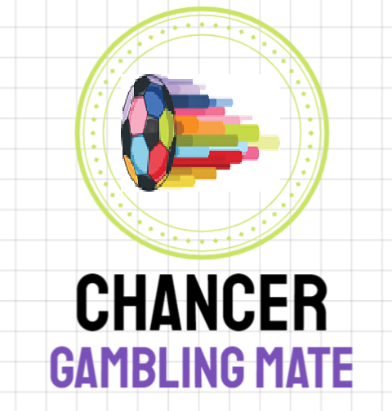
GOALS OF THE PROJECT
Allow gamblers to monitor their financial transactions with gambling firms to track the amount of money they are spending and provide psychology-informed deterrents to prevent them gambling in precarious financial position.
Provide gamblers with a machine learning model that uses advanced analytics features to predict the outcomes of future games for their perusal.

Slide 11
LITERATURE REVIEW

Slide 12
MACHINE LEARNING IN FOOTBALL
Inspiration for the data selection was from pi-football journal article that analyses the factors involved in the prediction of a football match(Constantinou et al., 2012).
The factors covered were the
Strength of the teams
Form of the teams
Psychological relationship of the match and the teams
Physical state of the teams
Pi-football study was conducted in the early 2010s before the advent of advanced analytics in football, hence statistics selected for this research focused on using new and improved statistics to improve the quality of the factors covered in pi-football
The accuracy of the pi-football model was 37.2%

Slide 13
USING VISUAL AIDS TO CURB ADDICTION
Research findings from Block et al shows that recall of antidrug advertising was associated with a lower probability of marijuana and cocaine use. However, recall of such advertising was not associated with the decision of how of the drug to use (2012).
These findings substantiate that anti-drug advertisements are good for addicts and therefore, it would be useful to incorporate them in the application to help the gamblers.

Slide 14
GAMBLER’S FEELINGS
From research, into the addictions and how the behavior of addicts towards the activity is important in understanding the types of behavioral change techniques that can be deployed inside the application.
From the research by Matheson et. Al, information about the feelings of gamblers as they bet is shown.
The results are positive towards gambling.

Slide 15
PROJECT IMPLEMENTATION

Slide 16
PROJECT IMPLEMENTATION
Training Machine Learning Model
Data Collection and Processing
Model development
Chancer mobile app
Front-end design
Back-end design
Mobile app review and interviews
Mobile application launch
Collection of data on application reviews and analysis
Model comparison and selection
Mobile app development

Slide 17

TRAINING MACHINE LEARNING MODEL

Slide 18
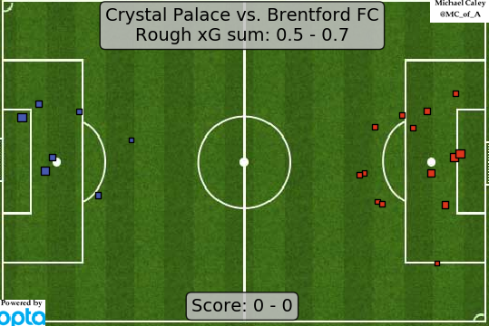
DATA COLLECTION AND PROCESSING
The data collection focused on the five highest-ranked football leagues according to the European football governing body (UEFA)
The advanced analytics features collected were
Expected goals
Non-shot expected goals
Importance of game
Sporting Power Index rating
Distance travelled for game
Days rest between matches
The other features to round up the data – goals, the results of the teams over the last 5 games.

Slide 19
MACHINE LEARNING MODEL
The model is a classification problem because there are three discrete outcomes possible in a football match; a home win, an away win or a tie.
Therefore, several classification models were run with the features and the one with the best accuracy was selected as the final model
Decision Tree Classifier
Naïve Bayes
Extreme Gradient Boost Classifier
Gradient Boosting Classifier
Support Vector Machines

Slide 20
MACHINE LEARNING MODEL COMPARISON
Naive Bayes had the best combination of precision, recall, and accuracy hence was selected as the best model for the model. Other high accuracy models like the boosting classifiers performed poorly in precision and recall of draw predictions.

Slide 21
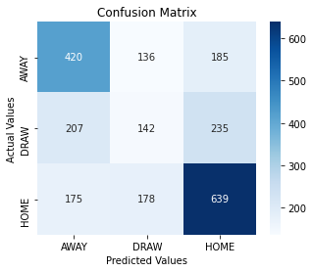
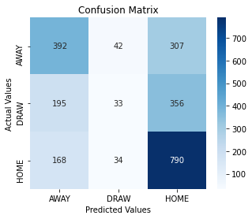
MACHINE LEARNING MODEL COMPARISON
Confusion Matrix
Naïve Bayes
Confusion Matrix
Gradient Classified Booster
Just 33 correct draw predictions by the Gradient Classified Booster

Slide 22
MACHINE LEARNING MODEL
The best performing algorithm –Naïve Bayes was used for the model.
In simple terms, a Naive Bayes classifier assumes that the presence of a particular feature in a class is unrelated to the presence of any other feature.
The algorithm was used in Python programming language.
Naive Bayes model is easy to build and particularly useful for very large data sets. Along with simplicity, Naive Bayes is known to outperform even highly sophisticated classification methods in multi-class classification problems
The accuracy of the model was tagged at 51.6% at predicting the result of the game either a home win, away win or a draw.

Slide 23
LATEST GAMES TEST and Results
Home Team | Away Team | Result | Model Prediction
Atalanta | Spezia | H | H
Lazio | Juventus | A | A
Fiorentina | AC Milan | H | A
Sassuolo | Cagliari | D | H
Salernitana | Sampdoria | A | H
Bologna | Venezia | A | H
Inter | Napoli | H | H
Genoa | Roma | A | A
Verona | Empoli | H | H
Torino | Udinese | H | D
10 Serie A games were selected from games played between 19/11/2021 -22/11/2021
The model predicted the results of 5 games accurately.

Slide 24

CHANCER MOBILE APP

Slide 25
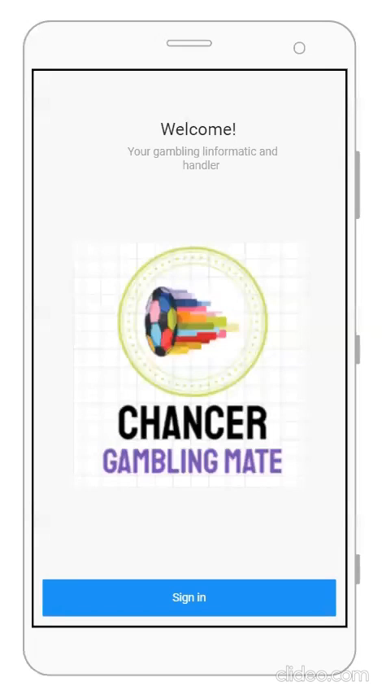
Front-End Design and App Functionalities
The Chancer app functions in a single mode – user mode.
A user, which can be represented, for instance, by a problem gambler.
The problem gambler can now see the match predictions for games by clicking on the leagues they want to see.
Also, one can access the financial information where they can input the bets – (the amount they bet and the amount they win from the bets) they have made over a period to practice self monitoring and set limits on their spending.
If the spending limits are exceeded then an image suggesting putting an end to gambling activities pops up.

Slide 26
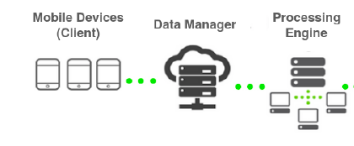
BACK-END DESIGN
The back-end of the Chancer app is composed of several software components.
The Client is the part managed by the app users. It uploads all the user’s data to the database to keep track of it, and it responds to any user input such as entering the bets for the week.
Data manager, which collects the football data in a real-time database, as well as stores the previous results and upcoming fixtures in the football calendar. It also holds the query logic that enables the user to search for games.
Processing engine is at the server side and holds the logic interface of the application, performing the machine learning model sending the predictions back to the client.

Slide 27
CONCLUSION & FUTURE WORKS

Slide 28
CHALLENGES FACED
Machine Learning component is problematic to run on a mobile application because
running machine learning models on mobile is performance intensive for the cell phones
Drains battery
Kills performance capabilities of other applications
running the model on a PC and then sending results to the app is problematic because it is dependent on operator. Human error due to forgetfulness.
Next alternative is to run the machine learning model on a small board computer such as the Raspberry Pi.

Slide 29
CONCLUSION
The research into problem gambling in Ghana indicates that most Ghanaians are interested in gambling to improve their financial issues.
To add, the focus of Ghanaian gambling is on sports betting primarily football.
The chancer mobile app providing predictions is controversial as it appears to encourage gambling but in the African setting, the aim is to prevent financial ruin as that is a real and common possibility.
The machine learning model was a relative success, especially in the field of football where there are three possible outcomes a success rate of 51.6% is good.

Slide 30
FUTURE WORKS
The complex set of harms, co-occurring issues, and population-specific challenges underscores the need for effective PG prevention and treatment services, but PG treatment-seeking rates remain low compared with treatments for other addictions, such as alcohol misuse (Matheson et. al, 2021)
Future work will involve making questionnaires and interviews to achieve a higher level of qualitative research into the population-specific challenges affecting rural Ghanaians to improve the quality of psychological intervention that is performed on the mobile application
Investigate other deterrents to gambling such as proving to the sports bettors who’s main is financial gain that it is next to impossible to maintain consistent winnings from gambling.
Test the response of the candidates with actual users to gauge their response to find out which behavioral change techniques are most effective.

Slide 31
REFERENCES
Odame, S. K., Quarshie, E. N.-B., Oti-Boadi, M., Andoh-Arthur, J., & Asante, K. O. (2020). Adolescent problem gambling in rural ghana: Prevalence and gender differentiation. Journal of Gambling Studies, 37(1), 83–105. https://doi.org/10.1007/s10899-020-09987-6
Glozah, F. N., Tolchard, B., & Pevalin, D. J. (2019). Participation and attitudes Towards gambling in Ghanaian YOUTH: An exploratory analysis of risk and protective factors. International Journal of Adolescent Medicine and Health, 33(4). https://doi.org/10.1515/ijamh-2018-0175
Hassanniakalager, A., & Newall, P. W. (2018). A machine learning perspective on responsible gambling. Behavioural Public Policy, 1–24. https://doi.org/10.31234/osf.io/sxbaq
Lopez-Gonzalez, H., Estévez, A. and Griffiths, M. (2017), ‘Marketing and advertising online sports betting: a problem gambling perspective’, Journal of Sport and Social Issues, 41(3): 256–272.
Markham, F., Young, M. and Doran, B. (2014), ‘Gambling expenditure predicts harm: evidence from a venue-level study’, Addiction, 109(9): 1509–1516
Constantinou, A., Fenton, N., & Neil, M. (2012). pi-football: A Bayesian network model for forecasting Association Football match outcomes. Knowledge-Based Systems, 36, 322-339. https://doi.org/10.1016/j.knosys.2012.07.008
Block, L., Morwitz, V., Putsis, W., & Sen, S. (2002). Assessing the Impact of Antidrug Advertising on Adolescent Drug Consumption: Results From a Behavioral Economic Model. American Journal Of Public Health, 92(8), 1346-1351. https://doi.org/10.2105/ajph.92.8.1346Victorian Casino and Gaming Authority Definition and Incidence of Pathological Gambling Including the Socioeconomic Distribution. Melbourne:Victorian Casinoand Gaming Authority; 1997.
Ofosu, Albert; Kotey, Richard Angelous (2020) : Does Sports Betting Affect Investment Behaviour? Evidence from Ghanaian Sports Betting Participants., Journal of Gambling Issues, ISSN 1910-7595, Centre for Addiction and Mental Health, Toronto, Vol. 43, pp. 61-83,
Matheson, F., Hamilton-Wright, S., McLuhan, A., Shi, J., Wiese, J., & Kryszajtys, D. et al. (2021). Self-Management Strategies for Problem Gambling in the Context of Poverty and Homelessness. Journal Of Gambling Issues, (48), 81-109. https://doi.org/10.4309/jgi.2021.48.4
St Quinton, T., & Morris, B. (2021). Gambling Prevention Mobile Applications: Understanding the Inclusion and Use of Behaviour Change Techniques. Journal Of Gambling Issues, (48), 110-121. https://doi.org/10.4309/jgi.2021.48.5St Quinton, T., & Morris, B. (2021). Gambling Prevention Mobile Applications: Understanding the Inclusion and Use of Behaviour Change Techniques. Journal Of Gambling Issues, (48), 110-121. https://doi.org/10.4309/jgi.2021.48.5

Slide 32
THANK YOU

